Slide 1
Hospital healthcare
Canly Hansen Sudirman
A brief explanation of what I think could be starters in presenting dashboard

Slide 2
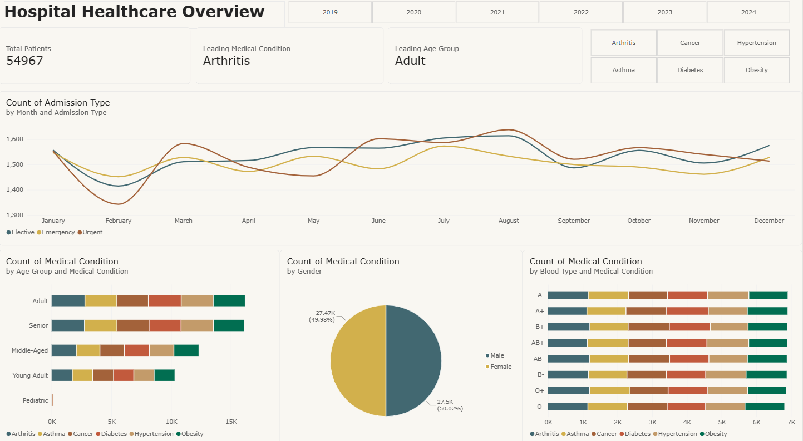
Dashboard overview
Dashboard shall show everything that needed to be said and provide simple set up, as to prevent audience to misunderstand what is being shown.
A theme is best if it fits to the organization.

Slide 3
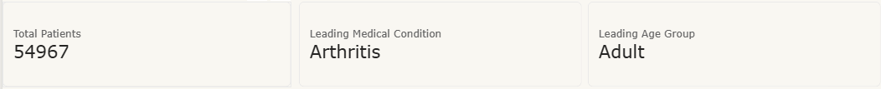
Main parameter (KPI)
The main parameters, or known as KPI if we are talking in business setting
They present as a general overview of our dataset. Here, I only use three because these three are what I want to convey to the audience.

Slide 4
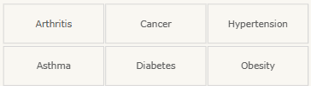
SLICERs
Use suitable options for slicers. Since I want my audience to understand the breakdown for every year and medical condition, I use them.

Slide 5
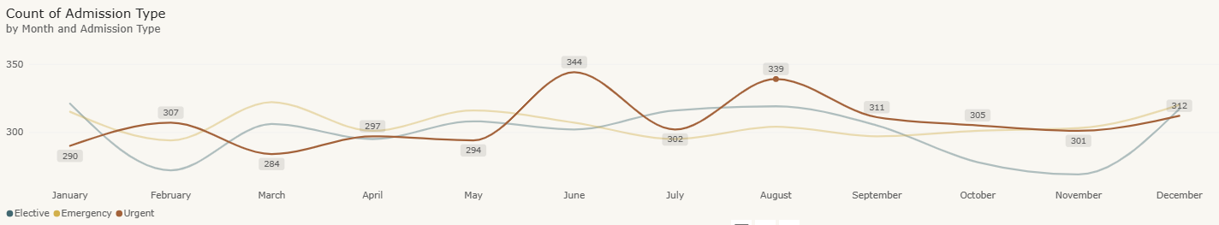
Trendline
Trendline is common in dashboard and in this particular example, I want to highlight Urgent case in the organization. As shown, I only show data labels on the line, because I want the audience to focus on the line. The other two lines are also greyed out to keep them from being distractions to what I want to show. Moreover, I added two arrows to show the significance the spikes found in two separate months.
spike

Slide 6
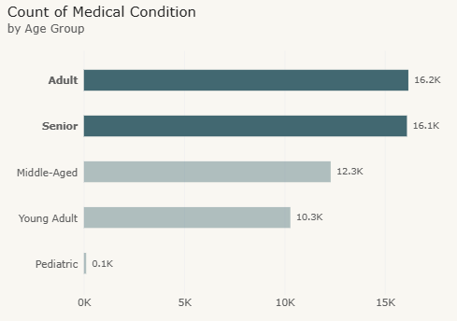
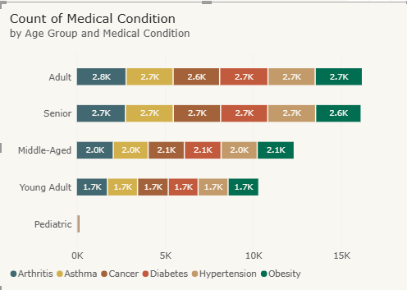
Digging deep into charts
There are considerations in formatting charts. Which do you think is a better chart to convey focused meaning?

Slide 7
Digging deep into charts
The second chart shows difference in every age group, but audience can only take so much information with those colors and numbers.
I like to present with more focused one core idea, which is why the first chart is objectively better when I want to show that there are two leading medical conditions in the case.

Slide 8
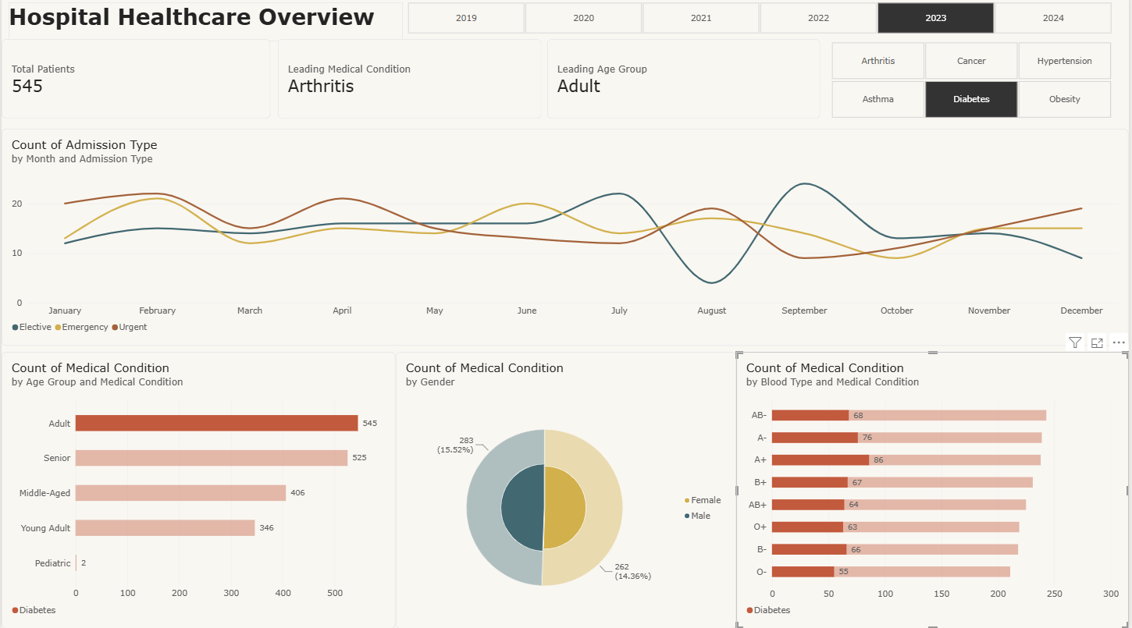
Utilization
The use of slicer is significant. For example, I want to show admitted Diabetes patients in 2023, I will have the whole charts in the dashboard show me that specific case.

